Slide 1
Python IOT
Microcontrollers, MicroPython, I/O

Slide 2
Python IOT
What is a Microcontroller?
A microcontroller is a small computer on a single metal-oxide-semiconductor integrated circuit chip. A microcontroller contains one or more CPUs along with memory and programmable input/output peripherals.
https://en.wikipedia.org/wiki/Microcontroller

Slide 3
Python IOT
What is a Microcontroller?
Non-volatile program memory in the form of ferroelectric RAM, NOR flash or OTP ROM is also often included on chip, as well as a small amount of RAM.
Non-volatile memory means that power is not needed to maintain the information stored on a chip.
https://en.wikipedia.org/wiki/Microcontroller

Slide 4
Python IOT
What is a Microcontroller?
Microcontrollers are designed for embedded applications, in contrast to the microprocessors used in personal computers or other general purpose applications consisting of various discrete chips.
https://en.wikipedia.org/wiki/Microcontroller

Slide 5
Python IOT
What is a Microcontroller?
Microcontrollers are used in automatically controlled products and devices, such as automobile engine control systems, implantable medical devices, remote controls, office machines, appliances, power tools, toys and other embedded systems.
By reducing the size and cost compared to a design that uses a separate microprocessor, memory, and input/output devices, microcontrollers make it economical to digitally control even more devices and processes.
https://en.wikipedia.org/wiki/Microcontroller

Slide 6
Python IOT
What is a Microcontroller?
Mixed signal microcontrollers are common, integrating analog components needed to control non-digital electronic systems.
In the context of the internet of things, microcontrollers are an economical and popular means of data collection, sensing and actuating the physical world as edge devices.
https://en.wikipedia.org/wiki/Microcontroller

Slide 7
Python IOT
ESP32
Robust Design
ESP32 is capable of functioning reliably in industrial environments, with an operating temperature ranging from –40°C to +125°C. Powered by advanced calibration circuitries, ESP32 can dynamically remove external circuit imperfections and adapt to changes in external conditions.
https://www.espressif.com/en/products/socs/esp32

Slide 8
Python IOT
ESP32
Ultra-Low Power Consumption
Engineered for mobile devices, wearable electronics and IoT applications, ESP32 achieves ultra-low power consumption with a combination of several types of proprietary software. ESP32 also includes state-of-the-art features, such as fine-grained clock gating, various power modes and dynamic power scaling.
https://www.espressif.com/en/products/socs/esp32

Slide 9
Python IOT
ESP32
High Level of Integration
ESP32 is highly-integrated with in-built antenna switches, power amplifier, low-noise receive amplifier, filters, and power management modules. ESP32 adds priceless functionality and versatility to your applications with minimal Printed Circuit Board (PCB) requirements.
https://www.espressif.com/en/products/socs/esp32

Slide 10
Python IOT
ESP32
Hybrid Wi-Fi & Bluetooth Chip
ESP32 can perform as a complete standalone system or as a slave device to a host MCU, reducing communication stack overhead on the main application processor. ESP32 can interface with other systems to provide Wi-Fi and Bluetooth functionality.
https://www.espressif.com/en/products/socs/esp32

Slide 11
Python IOT
GPIO – Tiny PICO
There are 20 pins on the GPIO:
One of the pins provides 5 volts
One pin provides 3.3 volts
One pin can be used to reset the tinyPICO
Two pins provide ground
Most of the remaining pins provide digital input / output of 3.3 volt

Slide 12
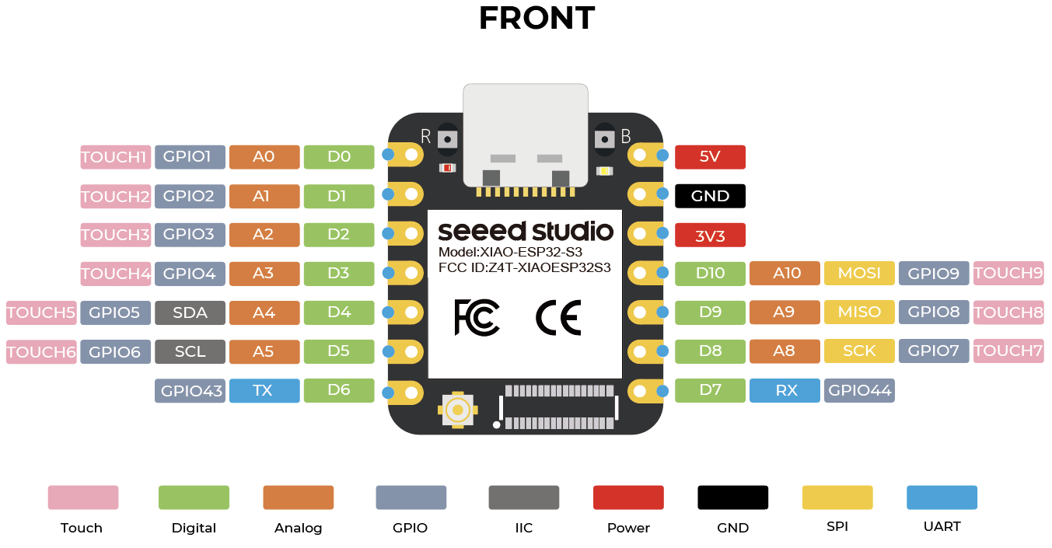
Python IOT
GPIO

Slide 13
Python IOT
Python
According to Wikipedia:
Python is a widely used high-level, general-purpose, interpreted, dynamic programming language. Its design philosophy emphasizes code readability, and its syntax allows programmers to express concepts in fewer lines of code than possible in other popular programming languages.
In other words, it’s easy to learn and you can do a lot with it!

Slide 14
Python IOT
MicroPython
MicroPython is a lean and efficient implementation of the Python 3 programming language that includes a small subset of the Python standard library and is optimized to run on microcontrollers and in constrained environments.
https://micropython.org/

Slide 15
Python IOT
MicroPython
MicroPython is a full Python compiler and runtime that runs on the bare-metal. You get an interactive prompt (the REPL) to execute commands immediately, along with the ability to run and import scripts from the built-in filesystem. The REPL has history, tab completion, auto-indent and paste mode for a great user experience.
https://micropython.org/

Slide 16
Python IOT
Output Devices - LEDs
Examine the MicroPython machine.Pin class:
https://docs.micropython.org/en/v1.15/library/machine.Pin.html

Slide 17
Python IOT
Output Devices - LEDs
Let’s create a program that turns an LED on/off
Complete Python IOT examples 1-3

Slide 18
Python IOT
MicroPython Function
Create a function to blink the LED 5 times (definite repetition)
Complete Python IOT example 4

Slide 19
Python IOT
MicroPython Scripts
Let’s save our function to blink an LED in a python script file
Complete Python IOT example 5

Slide 20
Python IOT
MicroPython Boot Scripts
There are two important files that MicroPython looks for in the root of its filesystem. These files contain MicroPython code that will be executed whenever the board is powered up or reset (i.e. it 'boots').
https://learn.adafruit.com/micropython-basics-load-files-and-run-code/boot-scripts

Slide 21
Python IOT
MicroPython Boot Scripts
/boot.py - This file is run first on power up/reset and should contain low-level code that sets up the board to finish booting.
/main.py - If this file exists it's run after boot.py and should contain any main script that you want to run when the board is powered up or reset.
https://learn.adafruit.com/micropython-basics-load-files-and-run-code/boot-scripts

Slide 22
Python IOT
MicroPython Boot Scripts
Let’s create (or edit) the main.py
Complete Python IOT example 6

Slide 23
Python IOT
Input Devices - Buttons
Let’s create a program that uses Input from a momentary switch
Complete Python IOT examples 7-8

Slide 24
Python IOT
Event Driven Programming
Computers will normally run programs sequentially – that is each instruction will execute in order until there are no more instructions left
If we want to create an event-driven program, we need the ability to have the computer “wait”until some event has occurred
When that event occurs, we can respond accordingly
To accomplish this, we need an infinite loop that is constantly checking to see if the event occurs (like pressing a button)

Slide 25
Python IOT
Synchronous vs Asynchronous Programming
A computer with a single CPU cannot process more than 1 instruction at a time – that is synchronous programming
When might that be an issue?

Slide 26
Python IOT
Synchronous vs Asynchronous Programming
Many programming languages have the ability to make a computer behave as if it can execute multiple instructions at a time even if there is only a single processor
While the CPU is “waiting” for an instruction to complete, it can complete other tasks
This is important if we want the computer to be able do more than flash an LED

Slide 27
Python IOT
Asynchronous Event Driven Programming
Create an asynchronous infinite loop
Complete Python IOT example 9

Slide 28
Python IOT
Input Devices - Buttons
Detecting a button “press” event is tricky due to switch “bouncing”
When you press a button, 2 pieces of metal come into and go out of contact several times before a solid connection is made
Without switch de-bouncing, a button will detect a press event every time the 2 pieces of metal connect
Generally speaking, this is undesirable

Slide 29
Python IOT
Input Devices - Buttons
Switch de-bouncing can be achieved with a hardware or software solution
The software approach involves using a timer
Instead of creating our own switch debouncing code, we will find a suitable library to handle button events
We will use mpy-lib written by Kevin Köck
This is an example of asynchronous code

Slide 30
Python IOT
Input Devices - Buttons
Create a simple asynchronous push button module that responds to button press
Complete Python IOT example 10

Slide 31
Python IOT
Asynchronous I/O
Create an advanced asynchronous push button module
This module allows you to create listeners for press, release, long(press) and double(click) events
The default time for long(press) is 3 seconds
Complete Python IOT example 11

Slide 32
Python IOT
OLED Screen
We are going to use a small OLED display to display or GPS data
The OLED display that we have is 128 pixels wide by 64 pixels tall
We will use the ssd1306 module created by Adafruit to manipulate the display
Complete Python IOT example 12 to demonstrate basic usage

Slide 33
Python IOT
GPS
Let’s learn a bit about GPS:
https://www.youtube.com/watch?v=U3eX6QKS9kY

Slide 34
Python IOT
GPS
The main takeaway from us from this video is that we need a minimum of 4 simultaneous satellite connections for accurate GPS data
The more connected satellites, the more accurate the data

Slide 35
Python IOT
Google Search GPS Accuracy
GPS accuracy depends on a number of factors, including the type of GPS receiver, the strength of the satellite signal, and the environment. GPS-enabled smartphones are usually accurate to within 16 ft (4.9 m) in open skies, but can be more accurate with the help of assistive services like Wi-Fi positioning. GPS receivers that use the L5 band can be accurate to within 12 in (30 cm), while high-end receivers used for land surveying and engineering can be accurate to within 3⁄4 in (2 cm).

Slide 36
Python IOT
GPS & UART
We are going to connect the GPS device to our MCU using the UART protocol
UART stands for universal asynchronous receiver / transmitter
It is a set of rules for transmitting serial data between 2 devices
Connecting the transmit(TX) pin from one device to the receive(RX) pin of another device allows us to transmit and receive messages between devices
For this example, we only need to transmit messages from the GPS device and receive them on the MCU

Slide 37
Python IOT
GPS & UART
Complete Python IOT example 13 to demonstrate basic usage
Note the red led on the GPS will be flashing when it is communicating with at least 4 satellites
b'\x00\x00\x89\x9ab\x92\xb2b\x92\x92\x92b\x8a\xc2b\xa2\xaab\x8a\xb2b\x82\xa2\x9ab\x9a\xaaR\xb2\x125\n$GNRMC,001051.000,A,4253.58866,N,08758.33342,W,0.00,107.59,140624,,,A*6A\r\n$GNVTG,107.59,T,,M,0.00,N,0.00,K,A*29\r\n$GNZDA,001051.000,14,06,2024,00,00*4A\r\n$GPTXT,01,01,01,ANTENNA OPEN*25\r\n’
The data is only useful if you know how to decode it

Slide 38
Python IOT
micropyGPS
We will use the micropyGPS module to assist us in decoding GPS data
Complete Python IOT example 14 to demonstrate basic usage

Slide 39
Python IOT
Save a target
We want to use the button press event to “save” the gps data as a target
We want to use the button long press event to “clear” the target
Complete Python IOT example 15

